Slide 1
Staff Selection Software In Java
Project By : Geetika Bhardwaj

Slide 2
PROFILE OF THE PROBLEM
Hiring Fast
Attracting Top Talent in corporate culture
To prevent the Lack of Quality Candidates
Technology Misalignment
Data Driven Recruitment for improving future Hiring
Recruiting Fairly

Slide 3
PROCESSING ENVIRONMENT (HARDWARE AND SOFTWARE USED)
Software used
Apache NetBeans ide (version 12.5)
XAMPP SERVER
Java development toolkit (version 18)
Hardware Used
Windows 10 (or 8.x)
Ram 4 gigabyte
Processor i3

Slide 4
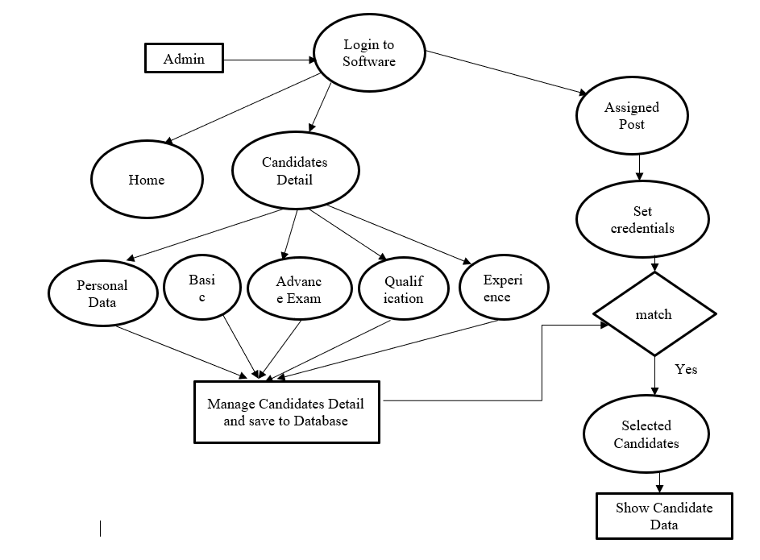
DATA FLOW DIAGRAM

Slide 5
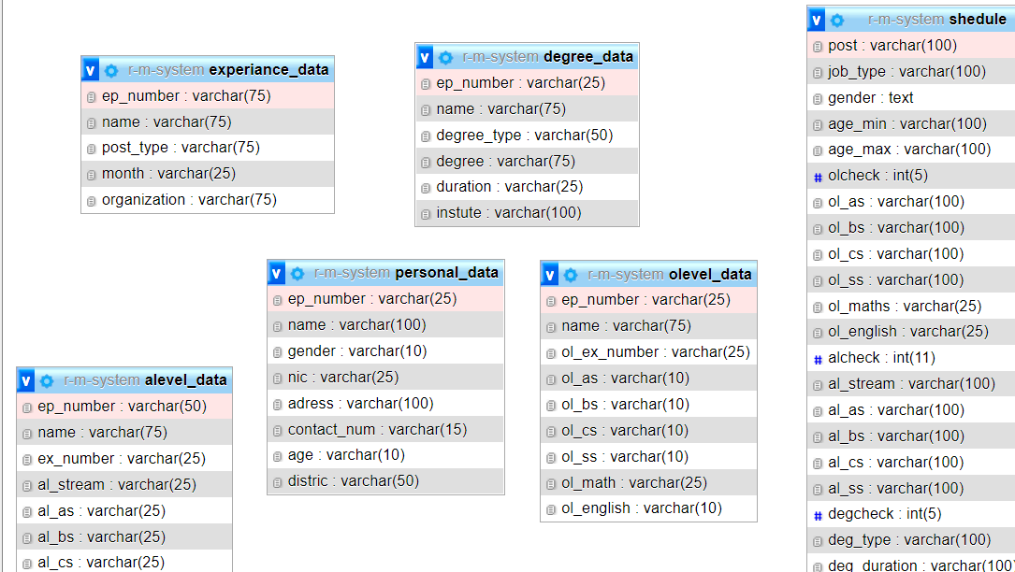
DATABASE DESIGN(TABLES USED)

Slide 6
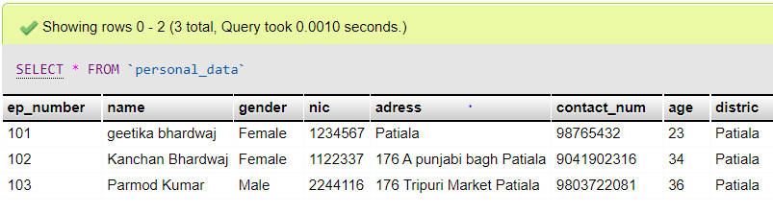
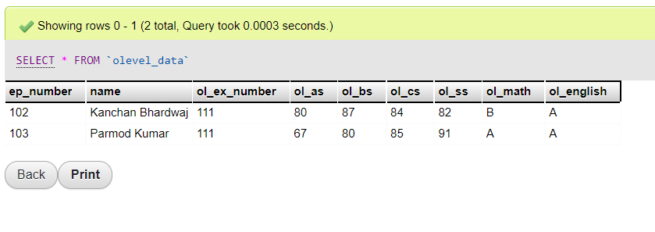
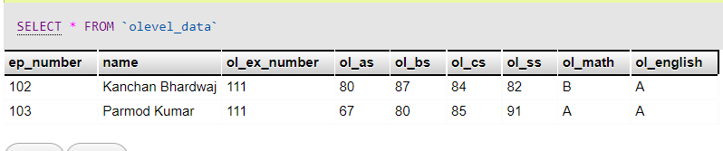
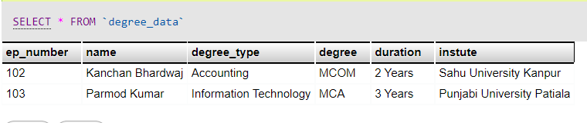

Slide 7
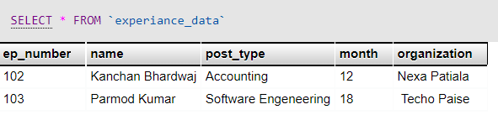
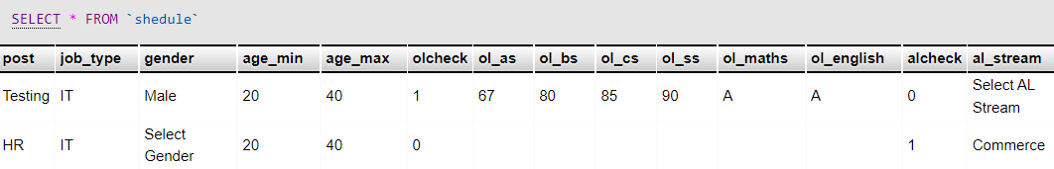

Slide 8
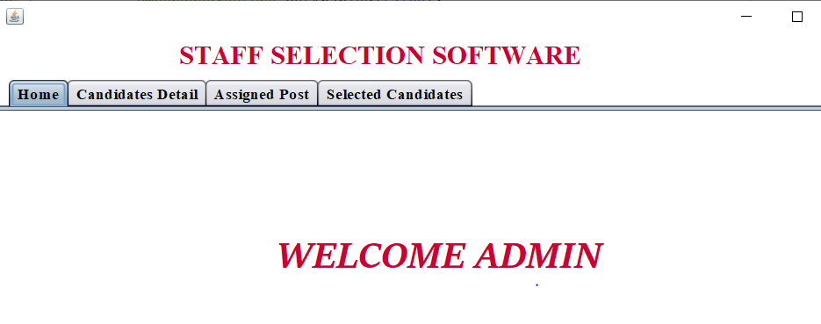
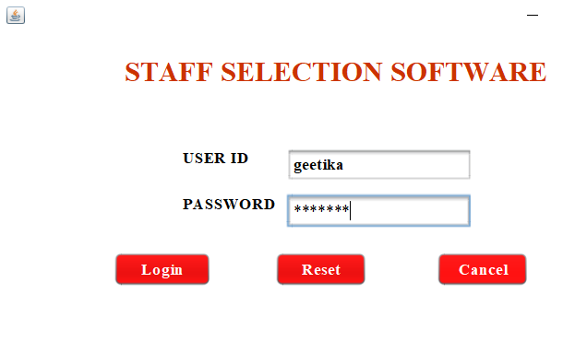
SNAPSHOT OF THE SYSTEM
Login Page
Homepage

Slide 9
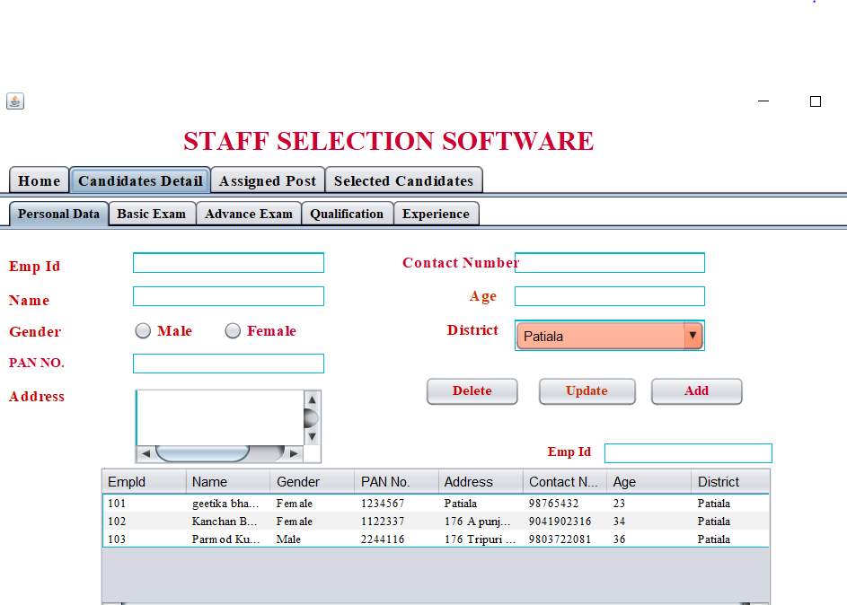
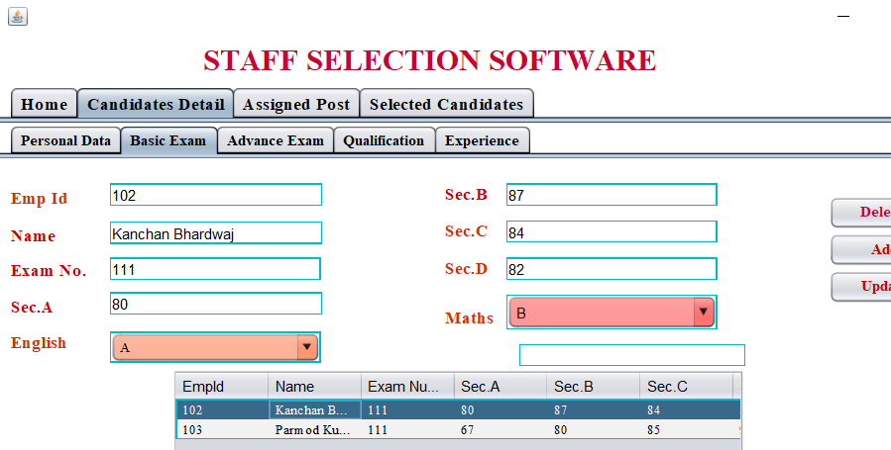
SNAPSHOT OF THE SYSTEM
PERSONAL /CANDIDATE DATA
EXAM DATA

Slide 10
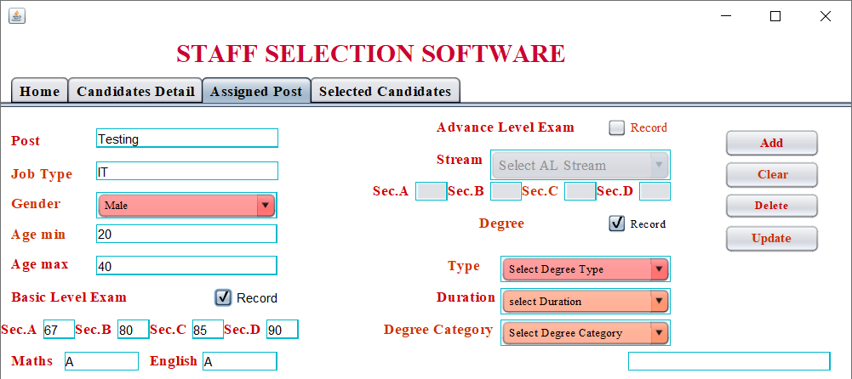
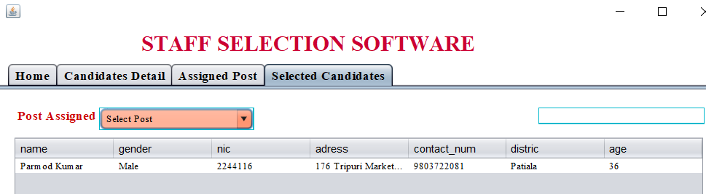
CREATING JOB AND FEEDING DATA

Slide 11
TEST CASES
Login denied if password /Username is wrong
Male/female Candidates were selected as per the data provided
All candidates were chosen if gender not provided while selecting candidates
SUCCESSFUL INSERT UPDATE OF DATA
FUTURE ENHANCEMENT
SAVING DIGITAL PHOTOS ,IDENTIFICATION CARDS,DIGITAL SIGNATURES
THANKS

